Slide 1
GAIA: Terrain Modeling with Erosion
FINAL PRESENTATION
CIS565 GPU Programming and Architecture
Vimanyu Jain & Mikey Chen

Slide 2
DEMO

Slide 3
EROSION – SIMULATION
TERRAIN INITIALIZATION
WATER INCREMENT
FLOW SIM FLUX UPDATE
WATER HEIGHT UPDATE
VELOCITY UPDATE
EROSION DEPOSITION
SEDIMENT TRANSPORT
EVAPORATION

Slide 4

Erosion - Input

Slide 5
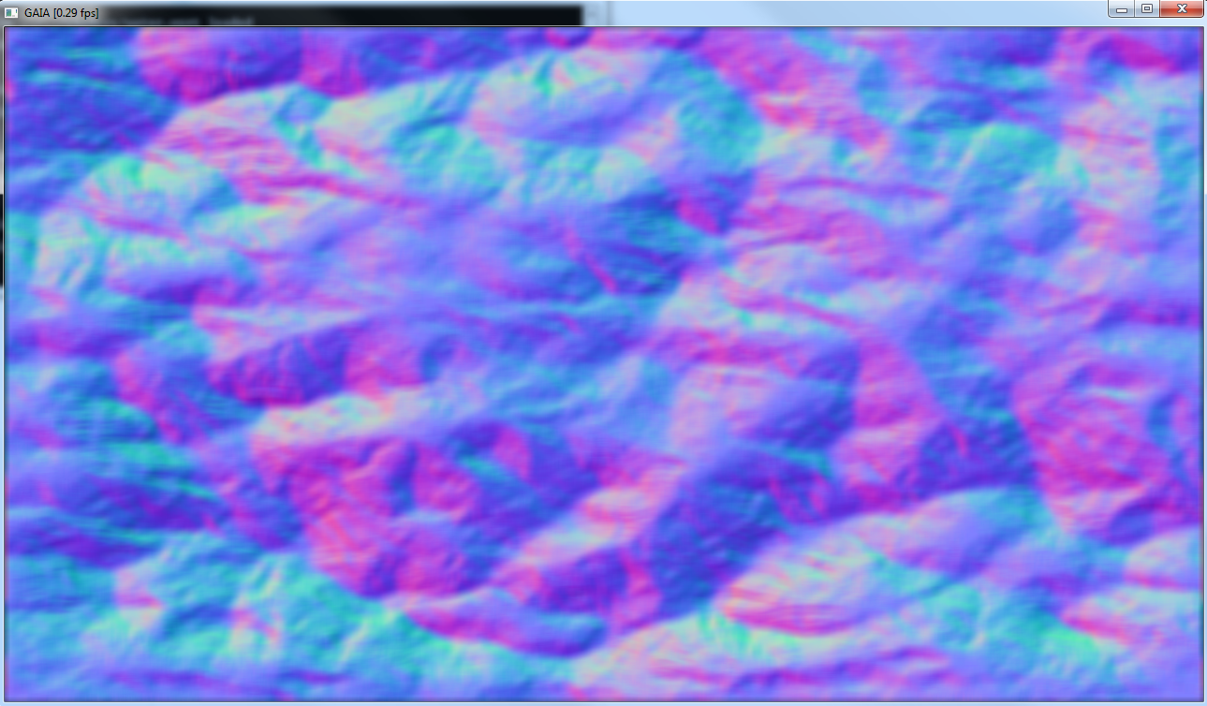
Erosion – extract normals

Slide 6
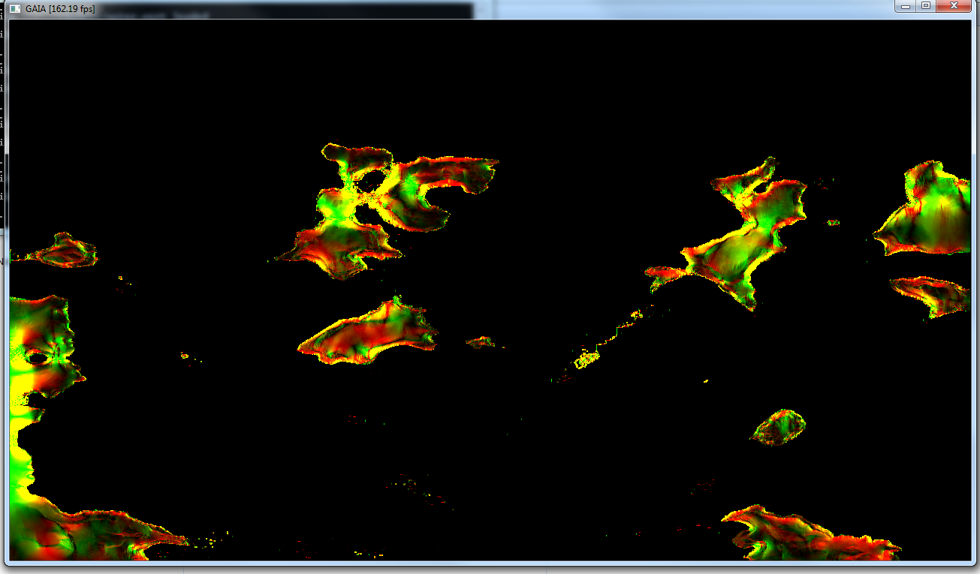
Erosion – velocity fields

Slide 7
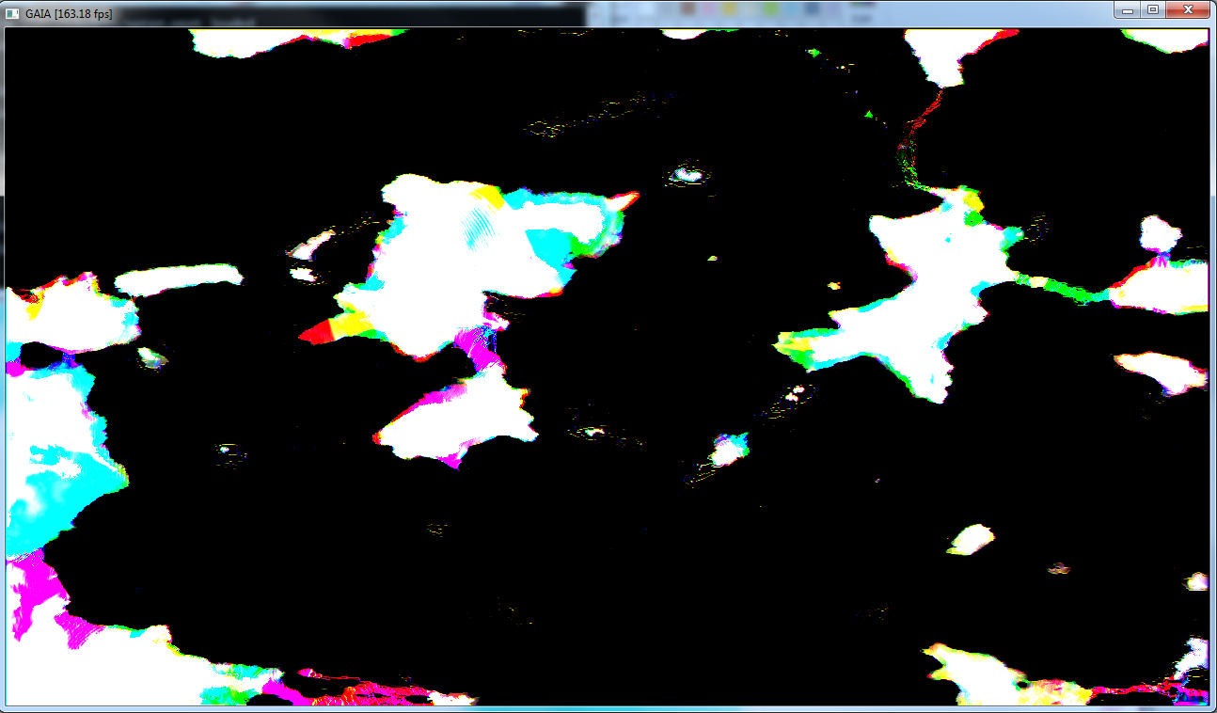
Erosion – flux

Slide 8
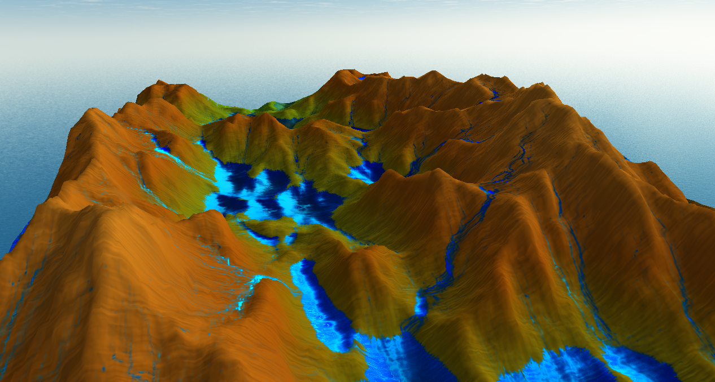
Erosion – rendering

Slide 9
Performance analysis
Pentium IV CPU(1.7 GHz) : 256X256 at 4 FPS (2007)
Pentium IV CPU(1.7 GHz) + 8800 GTX: 2048 X 2048 at 8 FPS (2007)
Xeon CPU (2.5 GHz) + 480 GTX: 2048 X 2048 at 40 FPS

Slide 10
REFERENCES
Fast Hydraulic Erosion and Simulation on GPU
Interactive terrain modeling using hydraulic erosion, by Ondrej et al
OpenGL Insights by Patrick Cozzi and Christopher Riccio
GPU Pro4 Advanced Rendering by Wolfgang Engel

Slide 11
THANK YOU!

